Slide 1
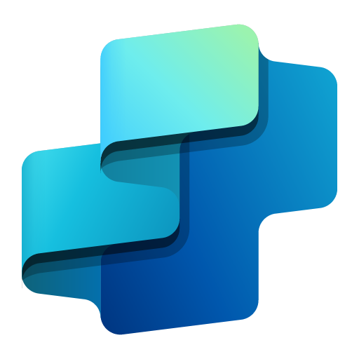

Publishing & Maintaining Copilot Studio Agents
alexander.Kastil@integrations.at

Slide 2
Agenda
Copilot Studio Basics
Extending Copilot Studio Agents Tools
Advanced Copilot Studio Agents
Monitoring Copilot Studio Agents

Slide 3
Publishing & Monitoring - Agenda
Environments, Solutions & the Admin Center
Publishing Agents & Advanced Channels
Application Lifecycle Management & Source Control
Governance, Compliance & Preventing Agent Sprawl

Slide 4
Publishing Overview

Slide 5
Publishing Agents
Prerequisites
Ensure user authentication is configured (Azure Active Directory or Microsoft Entra ID)
Configure Permissions
Open the agent in Copilot Studio → More (…) → Share.
Select Everyone in .
Choose User – can use the agent
Publish Agent
In Copilot Studio, open your agent and click Publish
Configure Channels
Go to the Channels tab and add where the agent should be available:
Microsoft Teams (for chats and meetings)
Microsoft 365 Copilot
Optional: SharePoint, custom websites, Power Pages, Azure Bot Service channels
Licensing
Ensure users have Copilot Studio User Licenses / PAYG

Slide 6
Artifacts Created When Publishing a Copilot Agent
Azure App Registration
Registers the agent as an application in Azure AD to enable secure authentication and API access.
Microsoft Teams App Package
If Teams is a selected channel, a .zip package is generated containing the manifest, icons, and configuration for deployment in Teams.
Bot Framework Registration
Links the agent to Azure Bot Services, enabling communication over supported channels like Teams, Web Chat, and more
Sets up endpoints and metadata for each enabled channel (Teams, Direct Line, Web, etc.).

Slide 7
Environment & Solutions Management

Slide 8
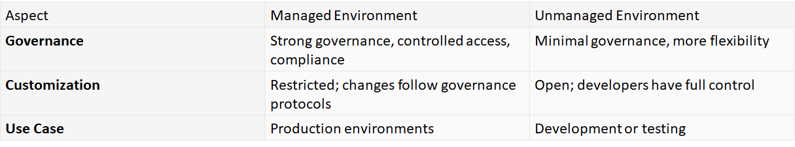
Managed vs Unmanaged Environments
A Managed Environment in Power Apps (and the broader Power Platform) is a premium governance feature set designed to help administrators manage environments at scale with more control, less effort, and better insights

Slide 9
Environment Types
Environment Type | Purpose | Key Features | Typical Use Case | Cost
Production | Live apps for end users | High reliability, full governance, security, backups | Business-critical solutions | Requires paid licenses
Sandbox | Development & testing | Can be reset or copied from production, safe for experimentation | Testing updates before going live | Requires paid licenses
Trial | Temporary evaluation | Full functionality, expires after ~30 days | Short-term evaluation of features | Free (time-limited)
Trial (Subscription) | Evaluation with subscription link | Similar to Trial but tied to subscription, convertible to Production | Pre-purchase evaluation | Included in subscription
Developer | Personal development & learning | Free with Developer Plan, not for production | Individual learning and app building | Free (Developer Plan)

Slide 10
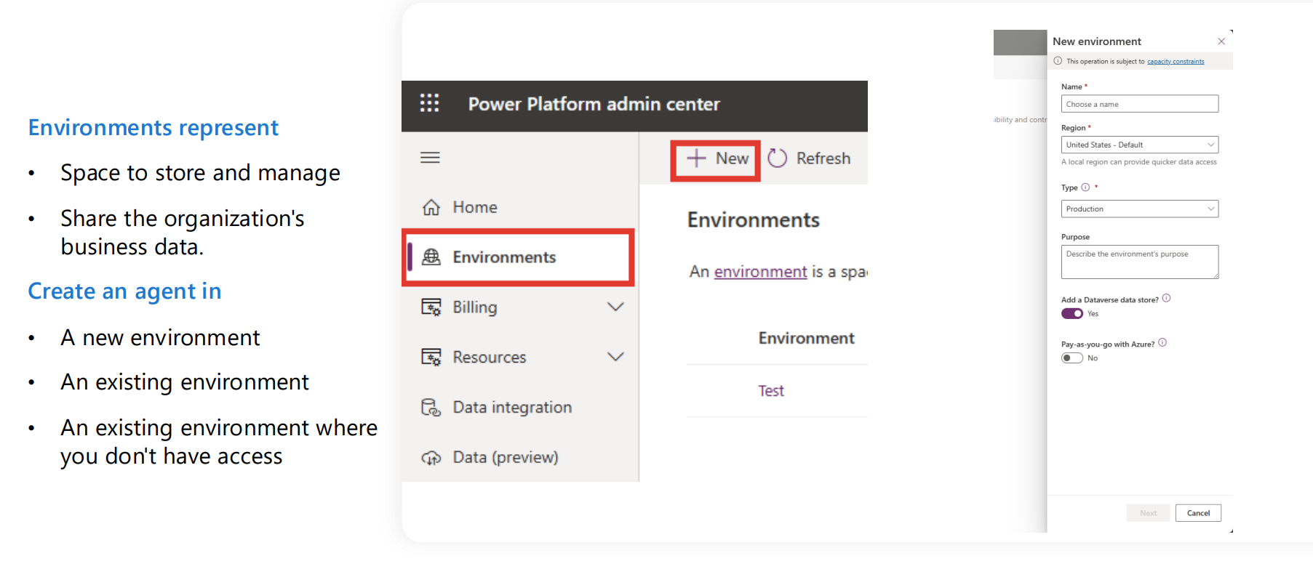
Working with environments

Slide 11
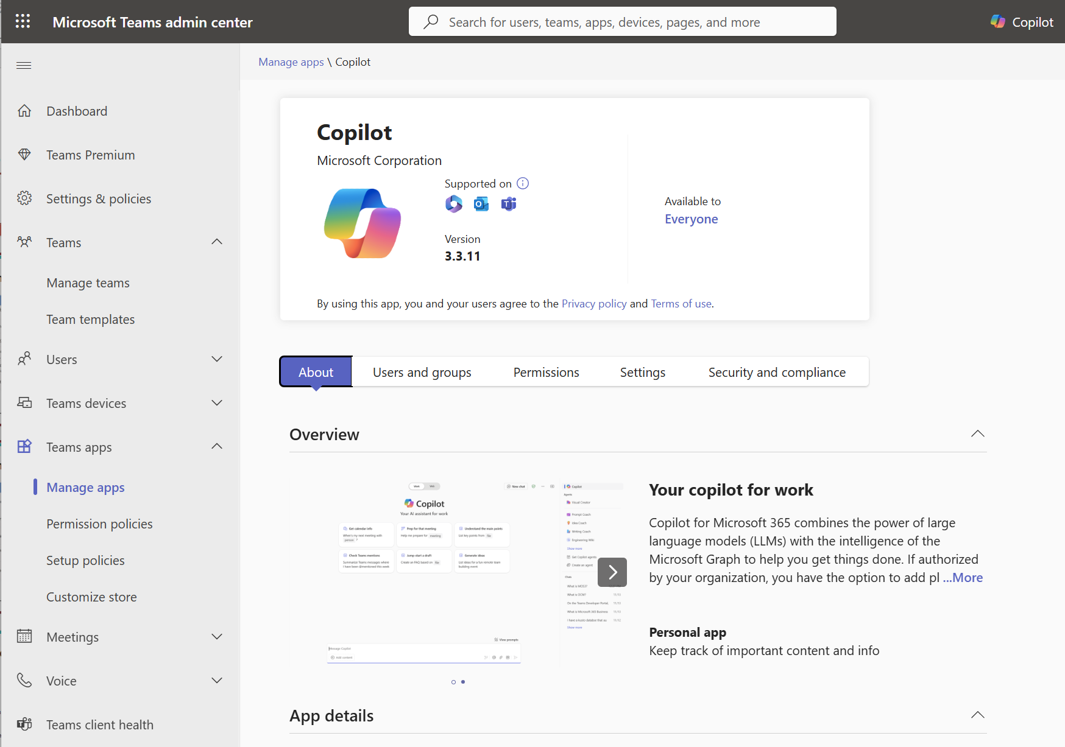
Teams Admin Center
The Teams Admin Center is a portal designed for managing and configuring Microsoft Teams within an organization.
You can govern all Teams apps available in your organization’s app catalog, define access to apps using policies, and manage app rollouts based on organizational needs.

Slide 12
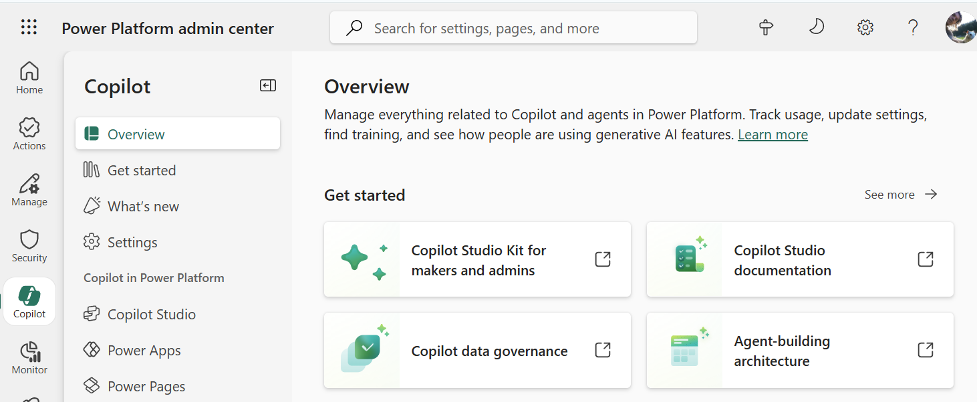
Power Platform Admin Center
Available at https://admin.powerplatform.microsoft.com/
Key Features:
Centralized Management
Environment
Data Loss Prevention (DLP) Policies
Analytics & Monitoring
Integration with Microsoft 365 & Azure

Slide 13
Power Platform Admin Center - Areas
Feature Area | Description
Actions | View recommendations about your Power Platform implementation. The recommendations enhance security, reliability, and overall health of your implementation.
Manage | Manage your environments, environment groups, and tenant settings.
Monitor | Measure and improve operational health metrics of resources built or deployed in Power Platform, such as apps.
Security | Run your organizational workloads in the safest way possible with a wide set of security features available.
Deployment | Provides a streamlined experience to help administrators navigate the complexities of managing Power Platform application lifecycle management (ALM) workloads, including managing pipelines deployments at enterprise scale.
Licensing | View a summary of environments in your tenant requiring licensing attention and license consumption for your environments.
Copilot | Access educational resources, track usage, and access governance controls about Copilot features.

Slide 14
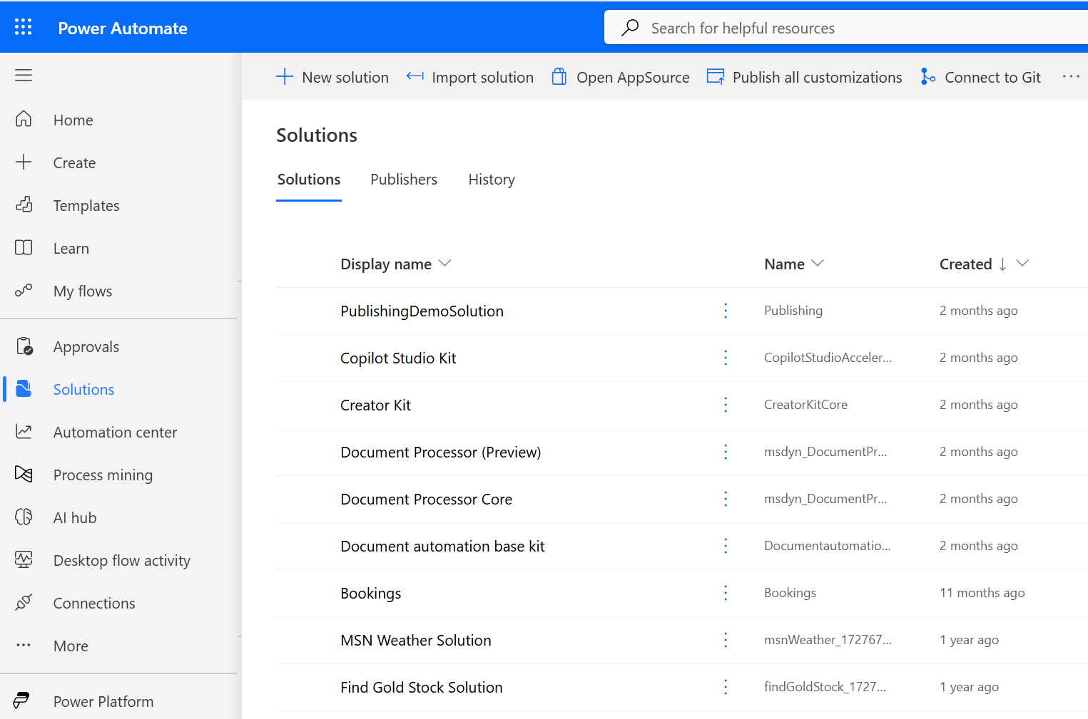
Solutions in Power Automate
Centralized Management of Apps and Flows
Solutions act as containers that group related Power Apps, flows, tables, and other components, making it easier to manage and deploy them together.
Application Lifecycle Management (ALM)
Supports versioning, patching, and deployment pipelines across environments (e.g., dev, test, prod), enabling structured and secure development workflows.
Environment-Aware Deployment
Solutions are designed to work across multiple environments, allowing administrators to move configurations and customizations seamlessly.

Slide 15
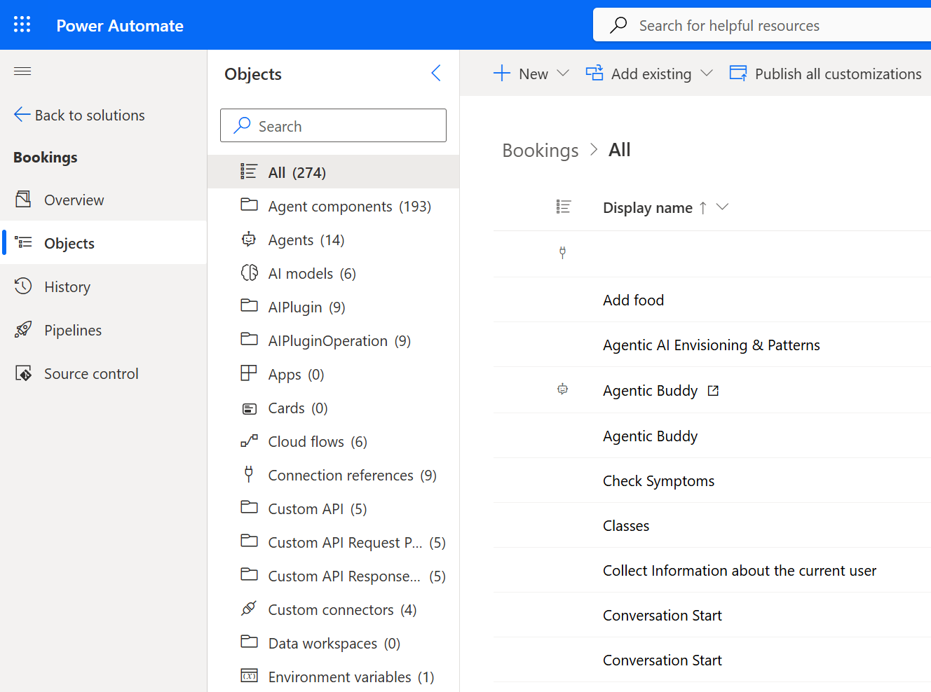
Solution Artifacts
A solution accts as a grouping container for Copilot Studio artifacts
Unified Packaging of Components
Supports ALM and Governance

Slide 16
Exporting Agents

Slide 17
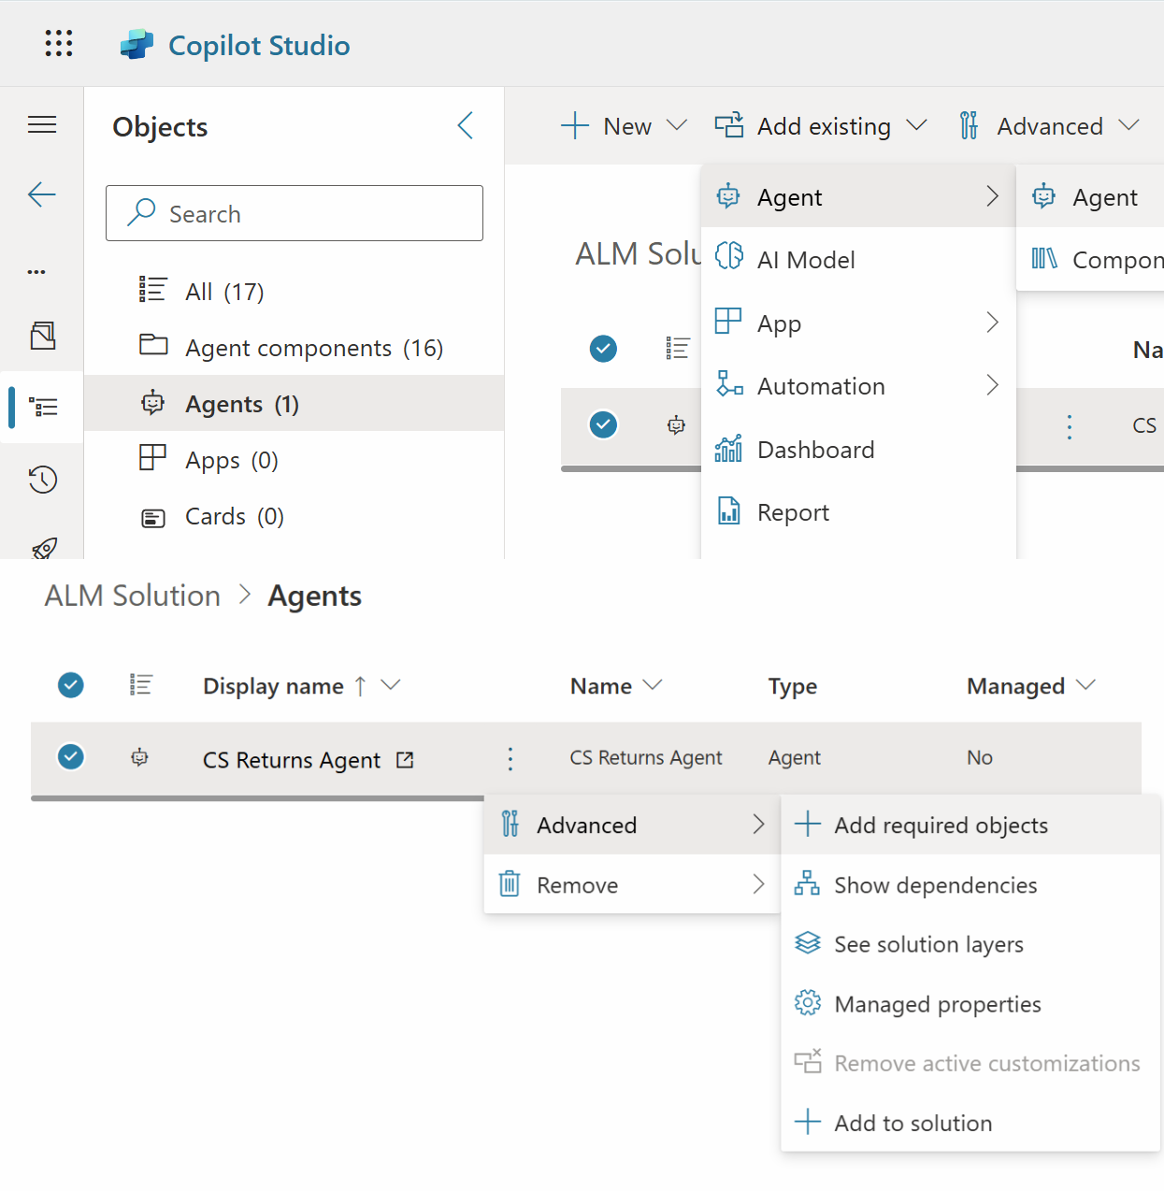
Exporting existing Agents
Go to Solution Exporer
Create a new Solution
Chose: Add existing -> Agent
Add the agent you want to add, then select it
Advanced -> Add required objects
Go back to the solution & run Solution checker
Export, then import in your target Environment

Slide 18
Deployment Pipelines

Slide 19
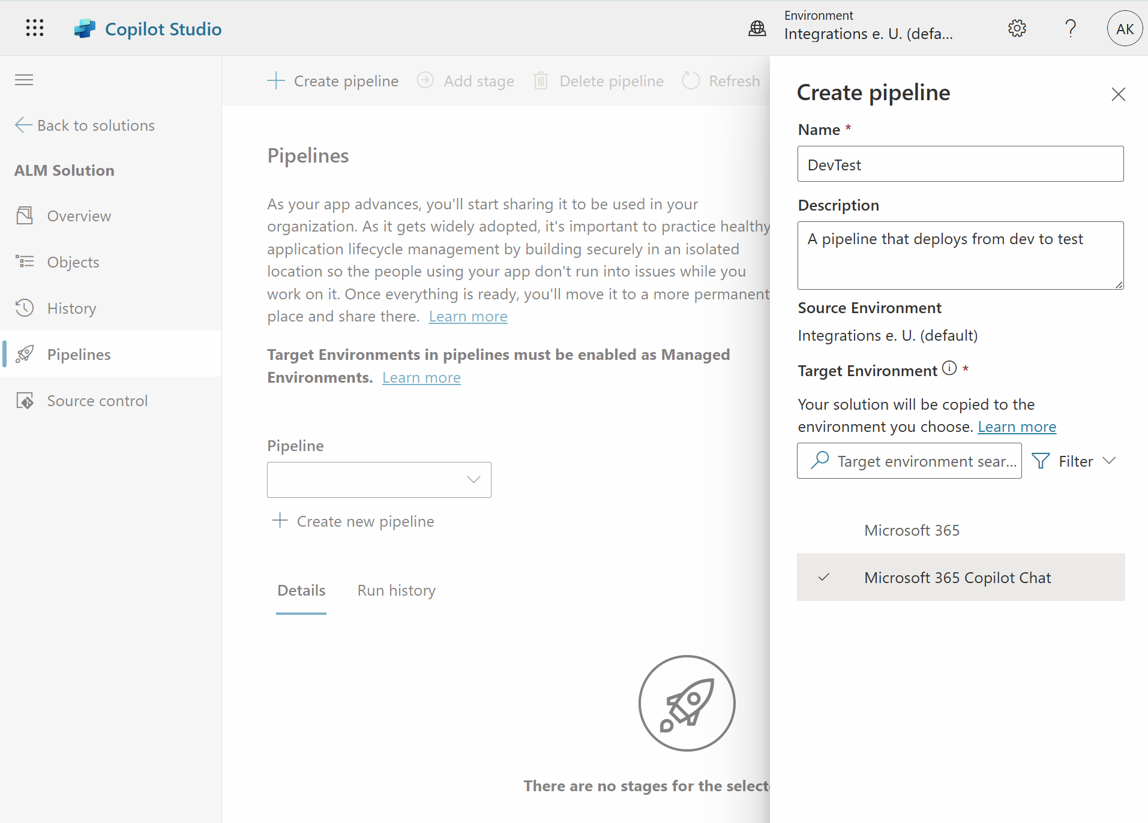
Deployment Pipelines for Copilot Studio Agents
Agent Design & Configuration
Define goals, skills, triggers, and conversation flows.Configure integrations
Testing & Validation
Use sandbox environments to simulate interactions.
Validate intents, responses, and fallback behavior.
CI/CD Integration
Automate deployment using GitHub Actions or Azure DevOps.Version control agent logic and assets.
Environment Management
Deploy to staging before production.Manage secrets and environment variables securely.

Slide 20
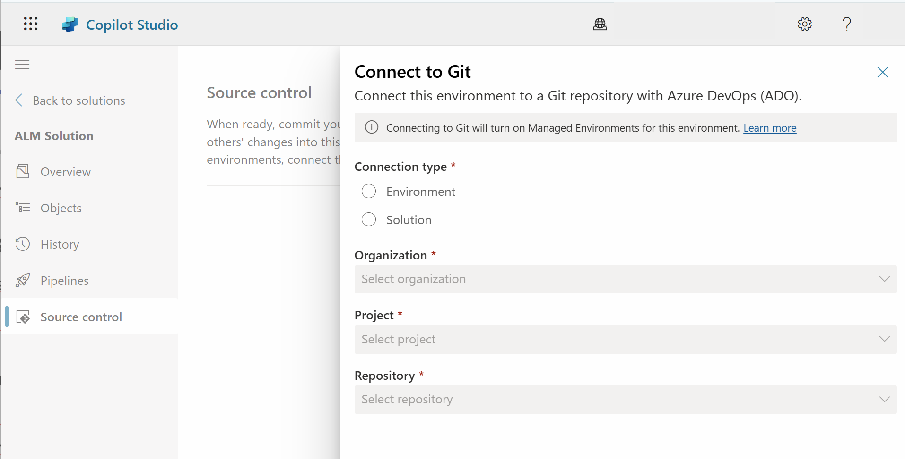
Source Control Integration
Version-Controlled Development
Store Copilot solution assets in Git repositories.
Enable collaboration, change tracking, and rollback
Connection Types
Environment vs Solution Connection
CI/CD Integration
Use GitHub Actions or Azure DevOps to automate validation and deployment.
Trigger builds and deployments on commit or pull request merge.
Governance & Review
Enforce pull request approvals and branch protection rules.

Slide 21
Using Analytics And Insights

Slide 22
Several Analytics Informations
Summary charts
Provide summary details, like the total number of sessions, resolution rates, outcomes, ...
Engagement over time chart
Observe how your users are engaging with your agents over a specific period.
Session outcomes over time chart
Provides percentages on how many sessions are being Resolved, Escalated, or Abandoned.
Resolution rate driver chart
Lists each topic and provides a resolution rate for it.
Escalation rate driver chart
Provides details that are related to sessions that have been escalated to a live agent.
Abandon rate driver chart
Provides details that are related to abandoned sessions.

Slide 23
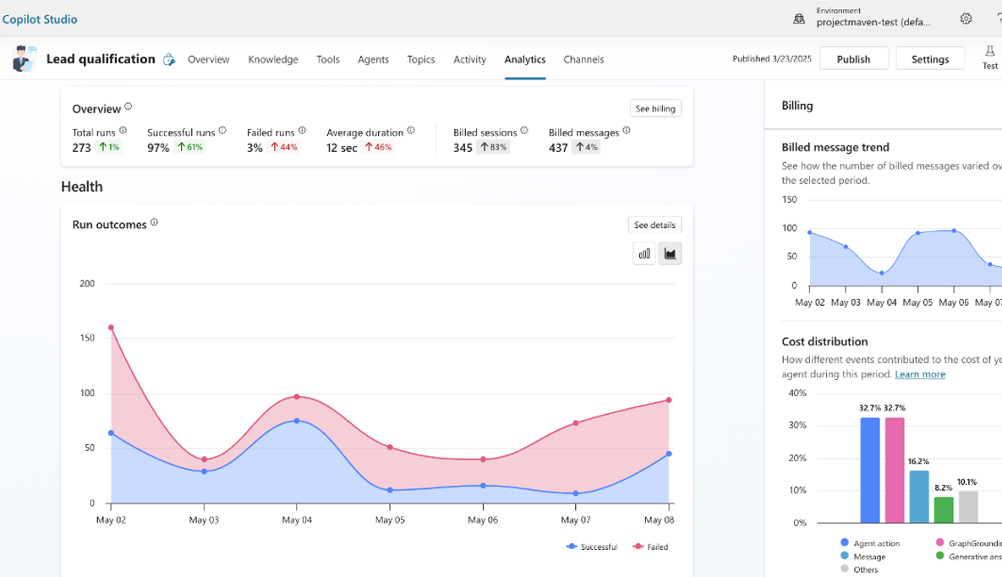
Analytics & Insights
Gain visibility into how your autonomous agents perform
Top KPIs
Total runs for the report period
Breakdown by successful & failed runs
Trend analysis over-time to easily identify areas that require close attention
Average run duration
Consumption analysis
Understand costs related to your agent in a detailed billing consumption report.
Message consumption over time.
Breakdown between type of events.
Notes:
Let’s dive into analytics and insights—now generally available in Copilot Studio.
You can gain visibility into how your autonomous agents perform using key performance indicators (KPIs).
Track total runs, breakdowns by successful and failed runs, and trend analysis over time to spot areas needing attention.
Analyze average run duration and consumption metrics, including detailed billing and message consumption reports.
These insights help you understand costs, usage patterns, and opportunities for optimization.

Slide 24
Copilot Studio Compliance

Slide 25
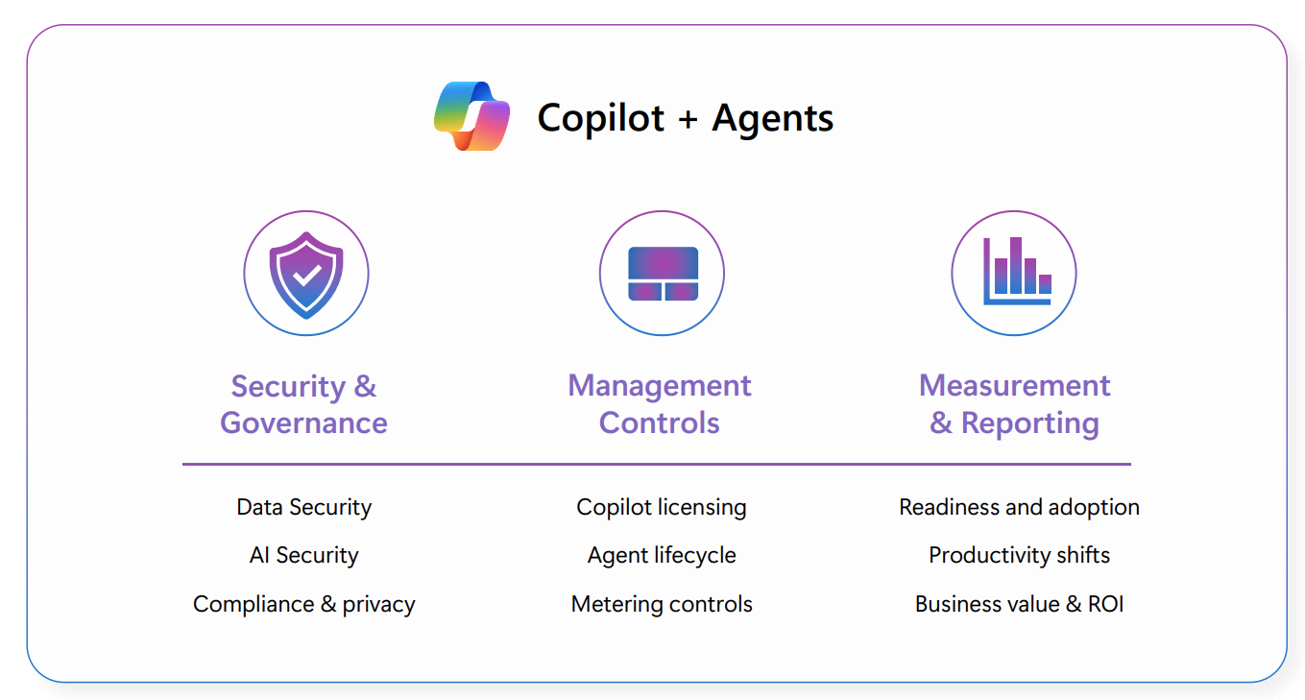
Copilot Control System

Slide 26
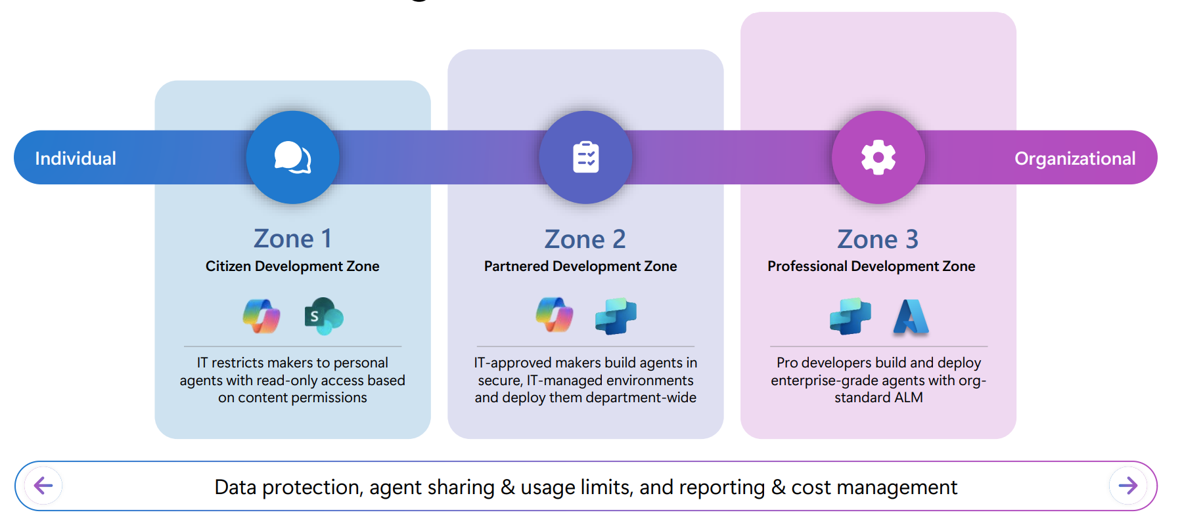
Agent Controls Model

Slide 27
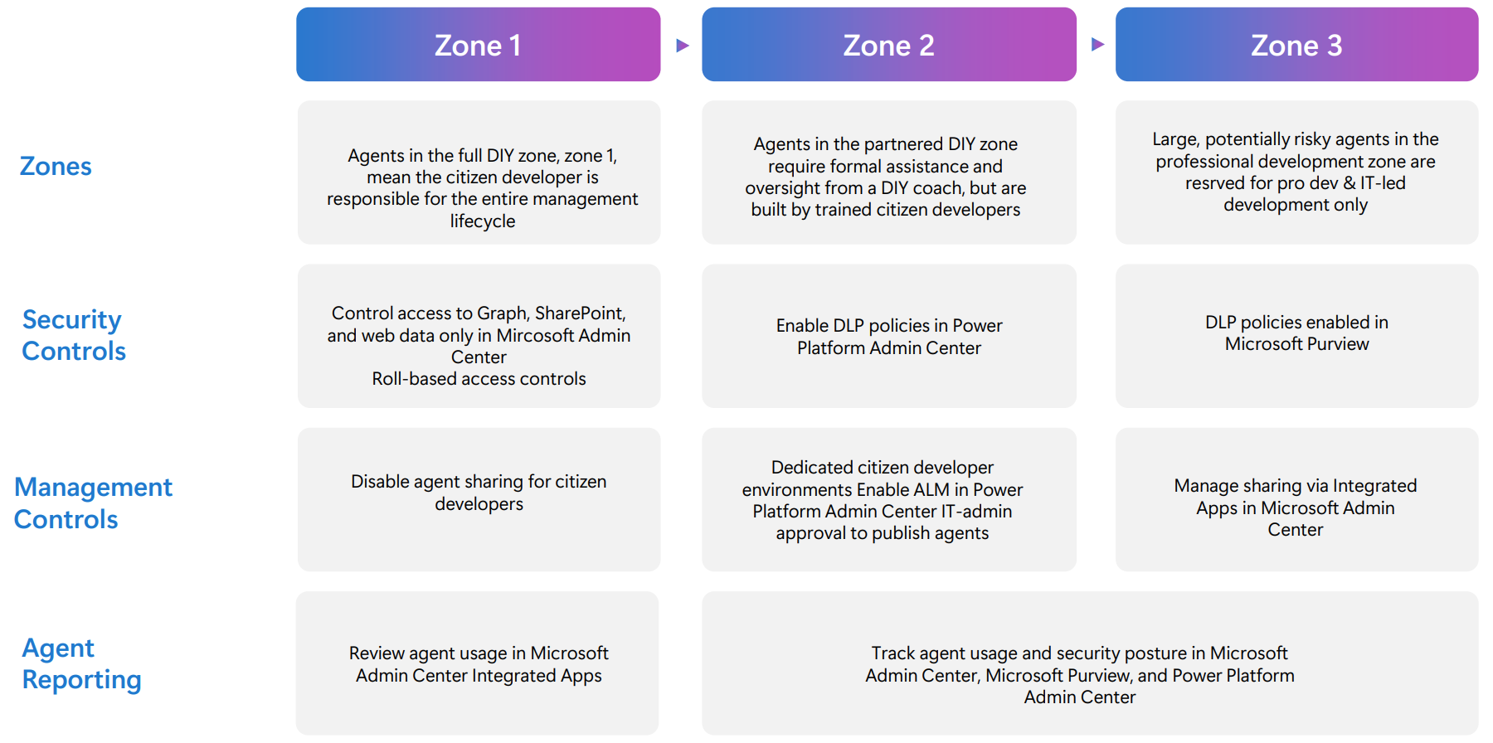
Agent Control Zones

Slide 28
Securing Data using Purview

Slide 29
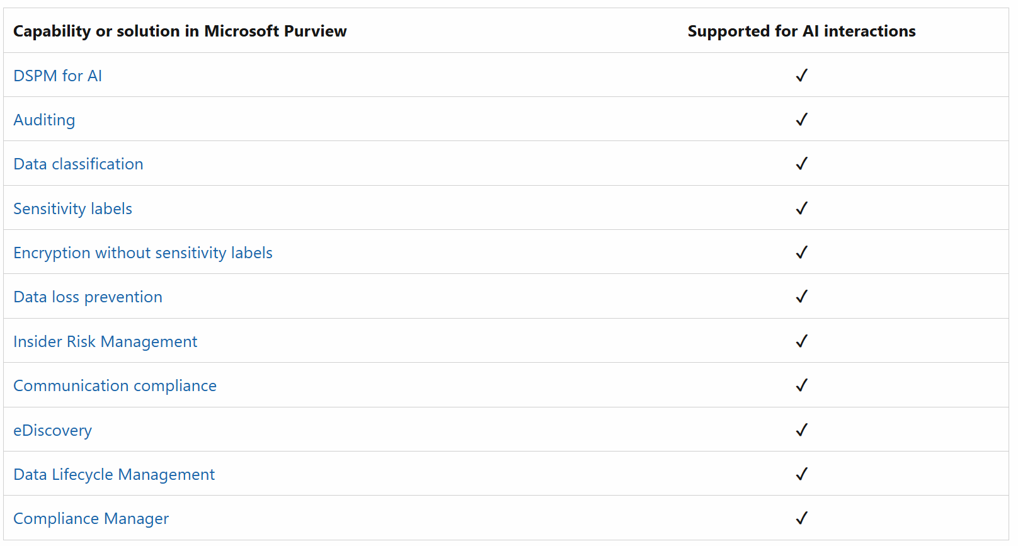
Microsoft Purview & Copilot
Unified Data Governance Platform
Purview helps organizations discover, classify, and manage data across hybrid environments—on-premises, multi-cloud, and SaaS.
Enabling Responsible AI
It ensures that data used by custom Copilots is secure, compliant, and well-governed, supporting ethical AI development.
Metadata & Lineage Tracking
Purview provides deep visibility into data sources, lineage, and usage—critical for transparency in AI-driven decisions.
Data Access Control
Integrates with Microsoft Entra and other identity solutions to enforce granular access policies for Copilot interactions.
Foundation for Trustworthy Copilots
By managing sensitive data and compliance risks, Purview lays the groundwork for building Copilots that users and regulators can trust

Slide 30
Purview Sensitivity Labels – Key Concepts
Purpose
Classify and protect data based on sensitivity (e.g., Confidential, Internal, Public).
Scope
Applies to files, emails, and containers (SharePoint sites, Teams, Groups).
Protection Features
Encryption: Restrict access to authorized users.
Content Marking: Add headers, footers, or watermarks.
Access Control: Define permissions and sharing rules.
Integration
Works across Microsoft 365 apps and services for consistent data protection.
Policy Enforcement
Labels can be auto-applied based on content or user actions.

Slide 31
Examples
File/Email Protection
Scenario: Q2_Budget.xlsx labeled Confidential – Finance.
Policy: Azure RMS encryption;
Only AAD group Finance has Viewer/Editor;
headers/footers show “Confidential – Finance”;
offline access limited to 7 days;
downgrade requires justification.
Effect:
Only Finance can open;
external share attempts are blocked;
forwarding/export is restricted
Auto-Labeling & Recommendations
Scenario: Docs containing passport numbers or codename “Project Falcon”.
Policy:
Auto-label to Confidential – Project when sensitive info or keywords detected;
Users see a recommendation prompt in Office apps;
Service-side auto-labeling in SharePoint/OneDrive applies protection at rest.
Effect:
Consistent labeling without user error;
Sensitive data stays encrypted and marked.

Slide 32
Purview Sensitivity Labels & Copilot
Data Awareness
Copilot respects sensitivity labels when accessing or generating content.
Compliance by Design
Copilot will not expose or suggest protected data beyond allowed permissions.
Contextual Responses
Uses labels to tailor answers without violating confidentiality.
Secure Collaboration
Ensures AI-driven insights stay within organizational compliance boundaries.

Slide 33
Copilot Examples
Summarizing Labeled Files
Scenario: User asks Copilot, “Summarize Q2_Budget.xlsx.”
File is Confidential – Finance.
Effect (Authorized user):
Copilot reads and summarizes; does not remove encryption—it simply returns insights the user is already permitted to see.
Effect (Unauthorized user):
Copilot responds that it can’t access the file; no content, snippets, or metadata leakage.
Email Label Inheritance & “Do Not Forward”
Scenario: Replying with Copilot to a thread labeled Confidential – Legal.
Effect:
The reply inherits the label;
Do Not Forward is enforced; if the user tries to downgrade (e.g., to Internal),
Outlook prompts for justification
Copilot’s drafted content stays within the applied protection.

Slide 34
Agent Sprawling

Slide 35
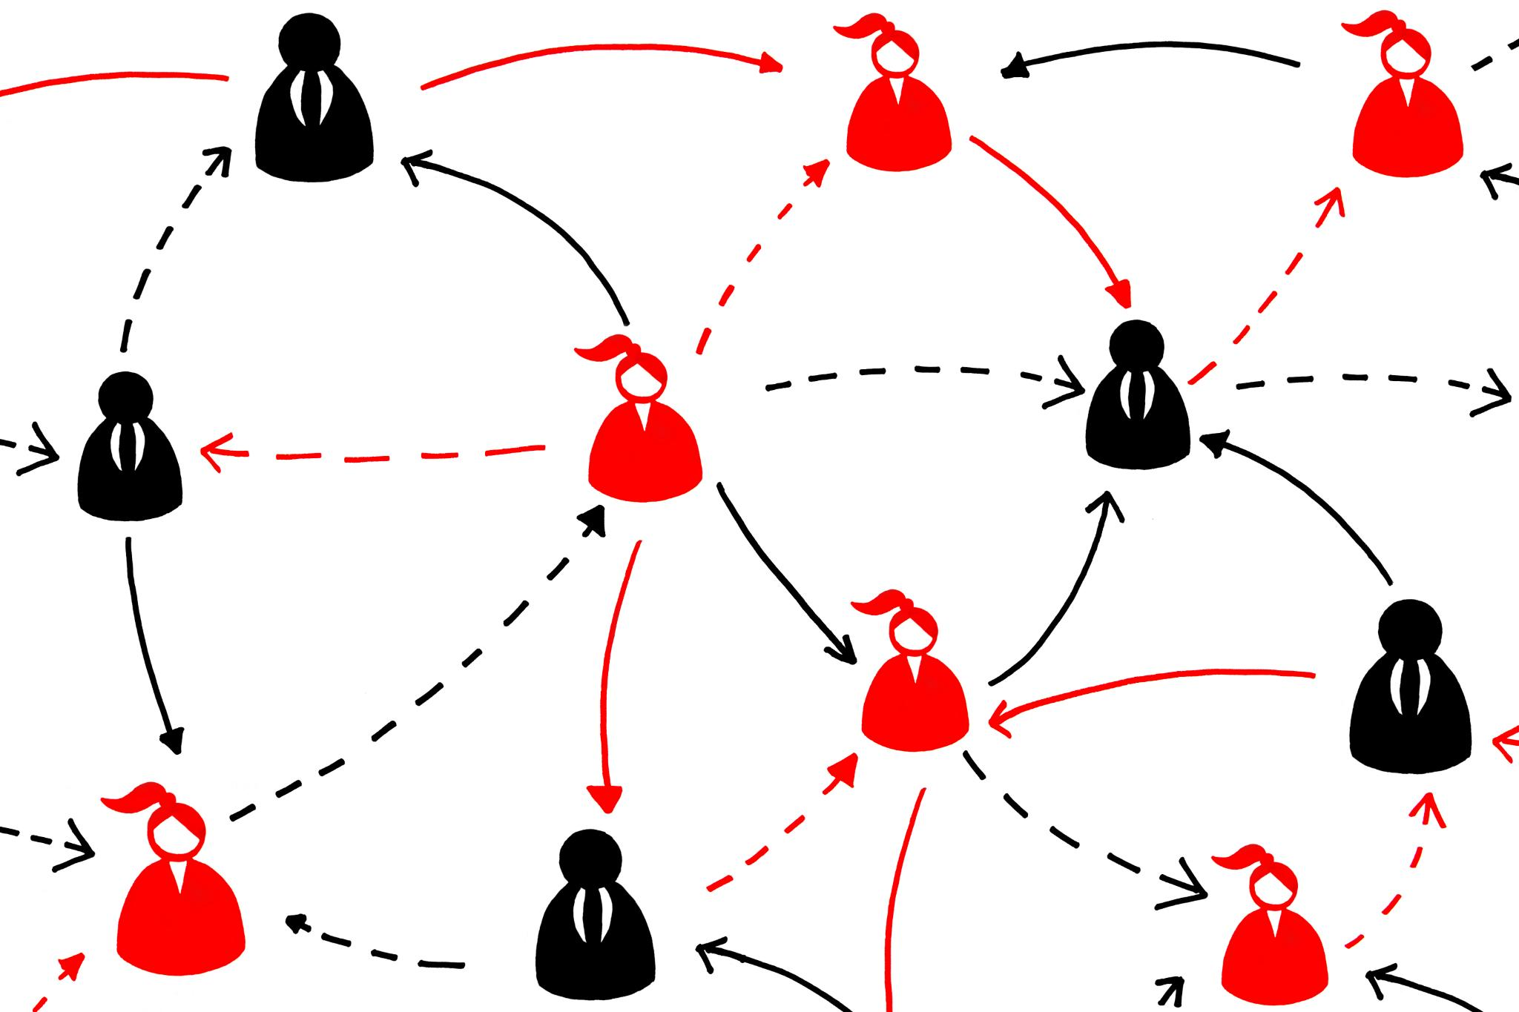
Agent Sprawl in Organizations
Agent Sprawl Definition
Agent sprawl occurs when AI and software agents proliferate uncontrollably across an organization.
Risks of Agent Sprawl
Duplicate functionalities and inconsistent controls increase security and compliance risks in organizations.
Best Practices Overview
Implement best practices to control agent sprawl when using low-code and pro-code agents in Microsoft 365.
Notes:
--- Preventing Agent Sprawl in Microsoft 365 (Low-Code & Pro-Code Agents) Agent sprawl is the uncontrolled proliferation of AI/software agents across an organization, which can result in duplicate functionalities, inconsistent controls, and increased security or compliance risks. To avoid agent sprawling when implementing both low-code and pro-code agents in Microsoft 365, consider these best practices: Image source: Microsoft 365 content library

Slide 36
Measure against Agent Sprawl
Use Microsoft Purview and Defender Integration
These tools help monitor data access, prevent oversharing, and detect vulnerabilities in agents throughout their lifecycle
Establish Clear Governance Policies
Define who can create, share, and manage agents.
Monitor and Audit Agent Activity
Regularly audit agent usage, performance, and data access patterns
Lifecycle Management
Implement processes for retiring outdated agents, consolidating similar ones, and maintaining documentation

